Slide 1
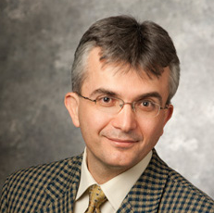
Towards Rawlsian fairness in food rescue
With Aydin Alptekinoglu

Slide 2
Food rescue operations
Act as a matching platform between donors and recipients
Active in 50 states, 2.9mil pounds in 2022, 52mil pounds in 2023
Donations below ~3000lbs, bulk donations are handled separately
Notes:
FL in 2023: ~20 mil pounds. Exciting time to be involved with them.

Slide 3

Food rescue operations
Act as a matching platform between donors and recipients
Each recipient sets a pickup radius, on avg. ~37km.
Notes:
Recipients are food pantries/ soup kitchens not individuals. Pickup radius, also categories interested in

Slide 4


Food rescue operations
Act as a matching platform between donors and recipients
Notes:
Different radii

Slide 5
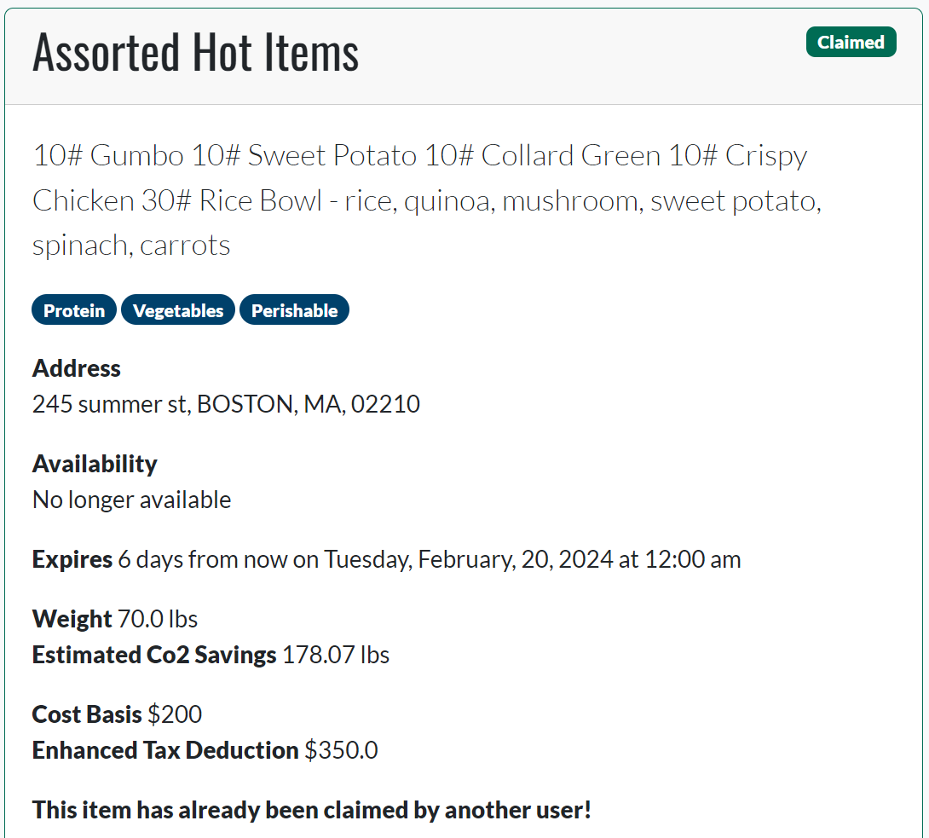
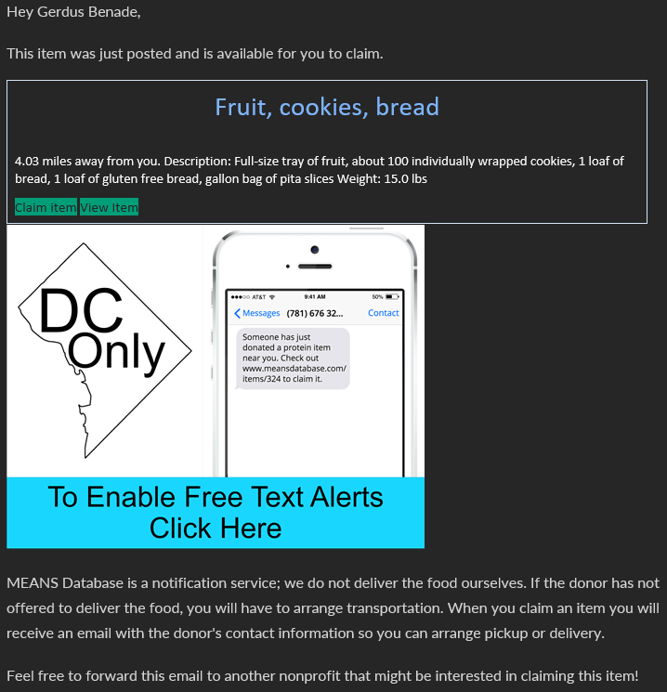

Slide 6

Food rescue operations
Act as a matching platform between donors and recipients
Notes:
Donation arrives – donors: farms/ larger scale factories / bakeries / catering companies or schools with prepared food

Slide 7
Food rescue operations
Act as a matching platform between donors and recipients
Notes:
Emphasize: recipient does transport (trying to offer delivery in a couple of states)
Deadline – expiration or shelf space

Slide 8
Food rescue operations
Act as a matching platform between donors and recipients
YES

Slide 9
Food rescue operations
Act as a matching platform between donors and recipients

Slide 10

Food rescue operations
Act as a matching platform between donors and recipients
YES
Notes:
Don’t know, and can’t elicit, agent values
We don’t get to make an allocation

Slide 11
Food rescue operations
Act as a matching platform between donors and recipients
Notes:
Don’t know, and can’t elicit, agent values
We don’t get to make an allocation

Slide 12
Food rescue operations
Act as a matching platform between donors and recipients
Active in 50 states, 2.9mil pounds in 2022, 52mil pounds in 2023
Historically
Vast majority of donations are successfully claimed
Average claim time ~5.5 hours, avg. deadline 210 hours
~90% of matched items travel less than 50km
Notes:
Bulk donations separate, drivers experiments in some cities, agreements with recurring donors

Slide 13
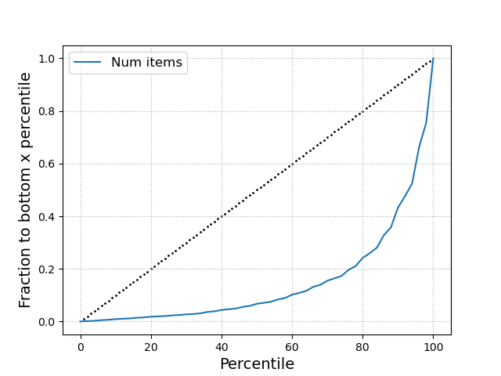
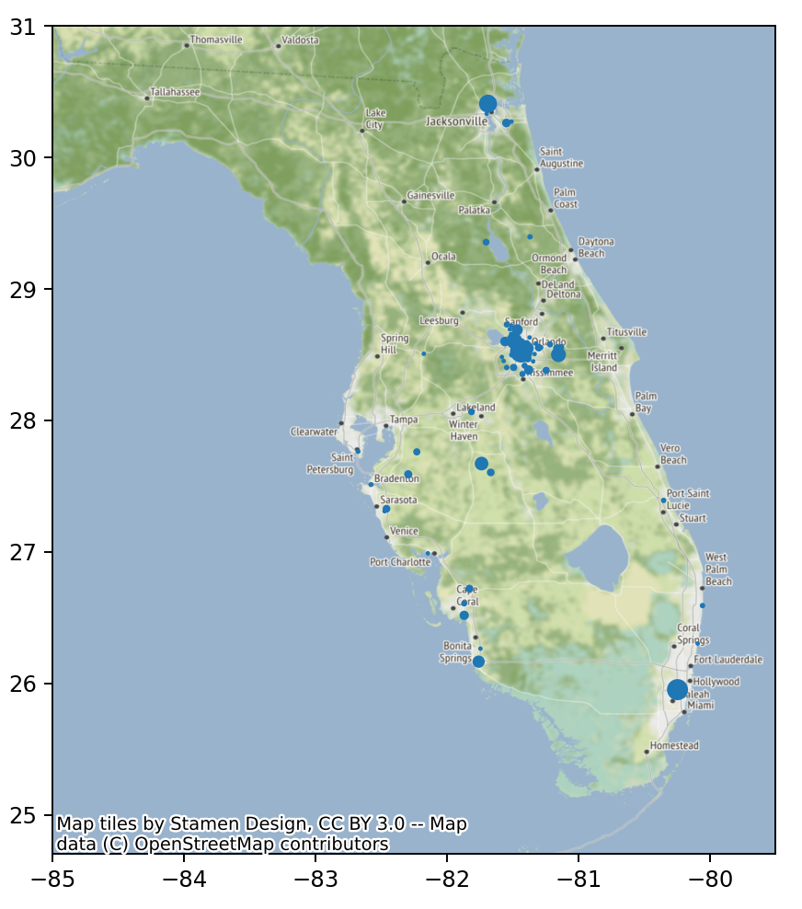
Outcomes: 2018- Sept 2023
Bottom 60% of recipients get 12% of items

Slide 14
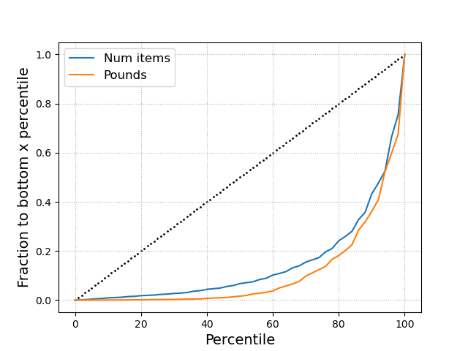
Outcomes: 2018- Sept 2023
Bottom 60% of recipients get 12% of items
Bottom 60% of recipients get 5% of weight
Notes:
These plots only consider those recipients that have received something since 2018
~70% of recipients signed up in FL have never received anything
Similar size organizations, all vying for relatively small donations <3000lbs, no bulk donations
Minimal changes from current system
- claiming system – cant allocate
- no value elicitation

Slide 16
Don’t know, and can’t elicit, agent values
We don’t get to make an allocation
Mi
Notes:
Values: firmly against. Categories of interest, rarely used. Market-based mechanisms need values

Slide 17
Our theory doesn’t really fit
Model
Here
Items arrive online
Agents have values for items
Fairness metric: envy
Algorithm decides allocation
Items arrive online
We don’t know item values
Can’t use envy as metric
Algorithm doesn’t get to allocate
Response rates

Slide 18



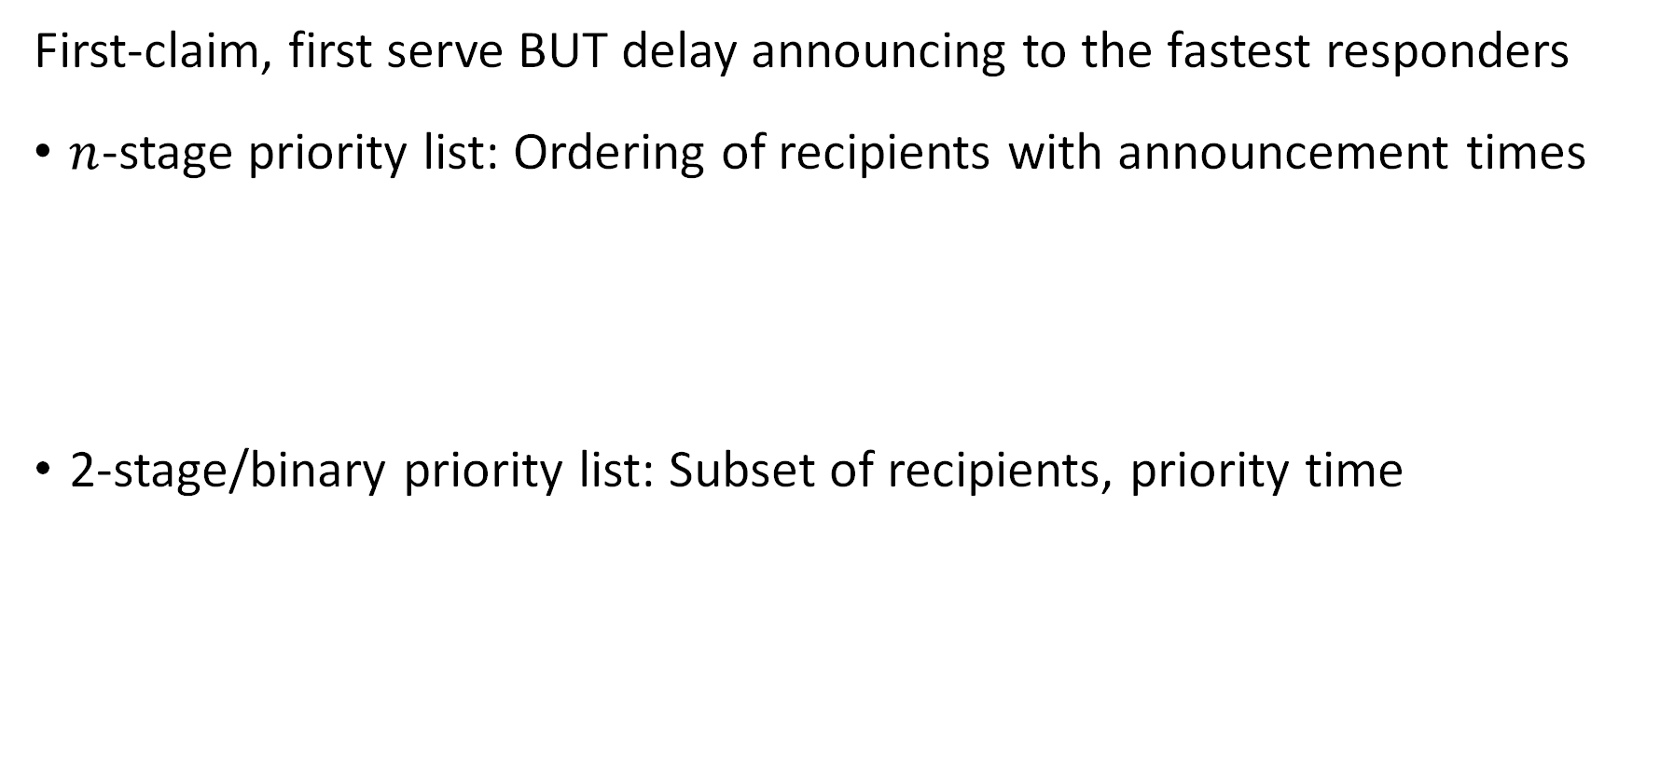
Priority lists
First-claim, first serve BUT delay announcing to the fastest responders
$n$-stage priority list: Ordering of recipients with announcement times
2-stage/binary priority list: Subset of recipients, priority time
1hr
3hrs
2 days
0
2hrs
2 days
0
Notes:
You could imagine other things, artificial currency, wait for two to respond give to worst-off etc

Slide 19
Priority lists
First-claim, first serve BUT delay announcing to the fastest responders
$n$-stage priority list: Ordering of recipients with announcement times
2-stage/binary priority list: Subset of recipients, priority time
0
1hr
3hrs
2 days
0
2hrs
2 days
Notes:
You could imagine other things, artificial currency, wait for two to respond give to worst-off etc
Added benefit – existed in some form eg church of some denomination prefers donation goes to food pantry of same denomination

Slide 20
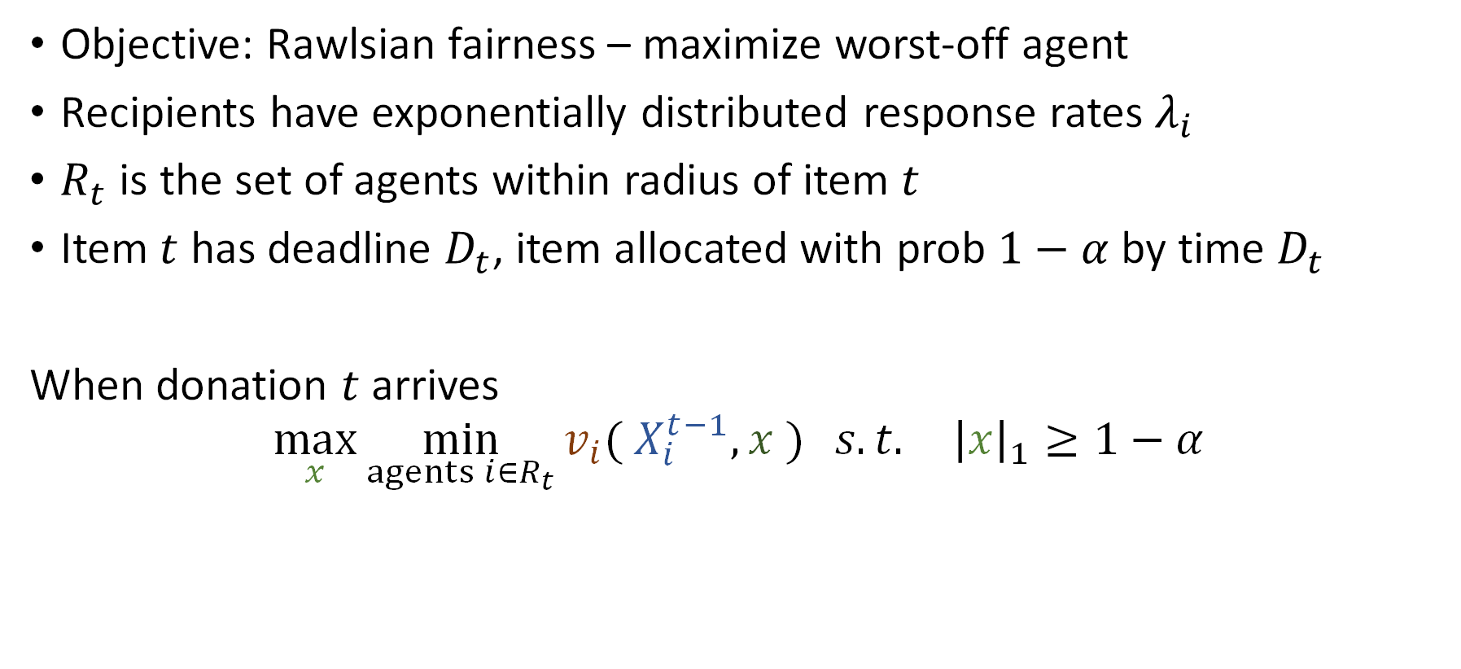
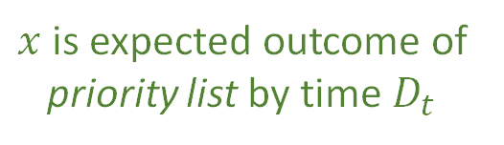
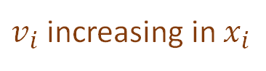

Model
Objective: Rawlsian fairness – maximize worst-off agent
Recipients have exponentially distributed response rates $λ_{i}$
$R_{t}$ is the set of agents within radius of item $t$
Item $t$ has deadline $D_{t}$, item allocated with prob $1−α$ by time $D_{t}$
When donation $t$ arrives
$$\max_{x}{\min_{agents i∈R_{t}}{v_{i}( X_{i}^{t−1}, x )} s.t. {\left|x\right|}_{1}≥1−α}$$
Existing allocation of prior items
Wastage constraint
Expected allocation of item $t$
$v_{i}$ increasing in $x_{i}$
$x$ is expected outcome of priority list by time $D_{t}$
Number of items
Pounds of items
Frac. of agent’s demand
Notes:
Objective – max unique recipients. Little demand information, couple of surveys, contacts etc, still enough uncertainty about what makes a reasonable objective.

Slide 21
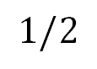
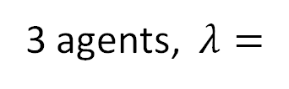

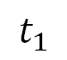

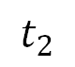
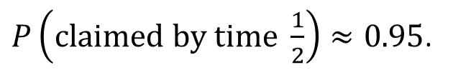

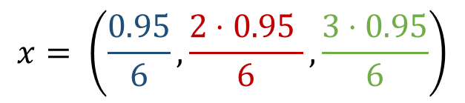
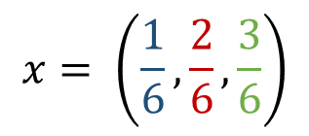
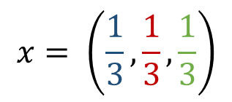
Example
1
2
3
3 agents, $λ=$
No deadline, no priority list
$$x= \left(\frac{1}{6},\frac{2}{6},\frac{3}{6}\right)$$
0
$$∞$$
No deadline, n-stage priority list
$$x= \left(\frac{1}{3},\frac{1}{3},\frac{1}{3}\right)$$
0
$$∞$$
$$t_{1}$$
$$t_{2}$$
Deadline of ½, $α=0.05,$ n-stage priority list
$P\left(claimed by time \frac{1}{2}\right)≈0.95$.
$$x= \left(\frac{0.95}{6},\frac{2⋅0.95 }{6},\frac{3⋅0.95}{6}\right)$$
0
$$1/2$$
Notes:
n-stage can achieve any fraction without deadline, 2 stage obviously cant

Slide 22

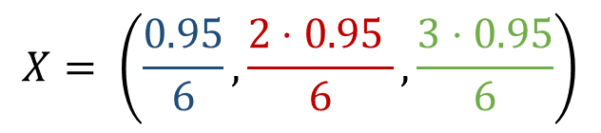
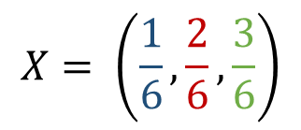
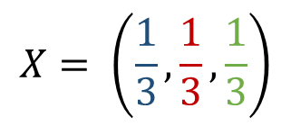
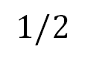
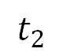
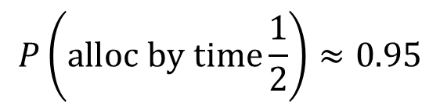
Example
1, 2, 3
No PL
$$∞$$
$$X= \left(\frac{1}{6},\frac{2}{6},\frac{3}{6}\right)$$
0
n-stage PL
$$X= \left(\frac{1}{3},\frac{1}{3},\frac{1}{3}\right)$$
$$t_{1}$$
$$t_{2}$$
$$∞$$
0
Deadline
$$P\left(alloc by time\frac{1}{2}\right)≈0.95$$
$$1/2$$
0
$$X= \left(\frac{0.95}{6},\frac{2⋅0.95 }{6},\frac{3⋅0.95}{6}\right)$$
Notes:
n-stage can achieve any fraction without deadline, 2 stage obviously cant

Slide 23
Example
Best with 2 stage priority list in same example

Slide 24
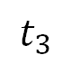
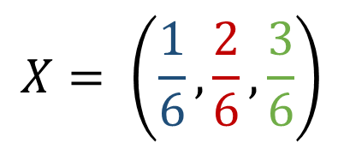
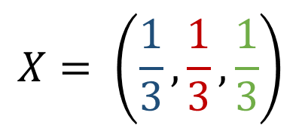
$$X= \left(\frac{1}{6},\frac{2}{6},\frac{3}{6}\right)$$
1
2
3
$$t_{2}$$
$$t_{3}$$
$$X= \left(\frac{1}{3},\frac{1}{3},\frac{1}{3}\right)$$
1
1
2
1
2
3

Slide 25
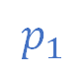
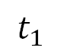
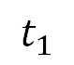
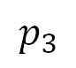
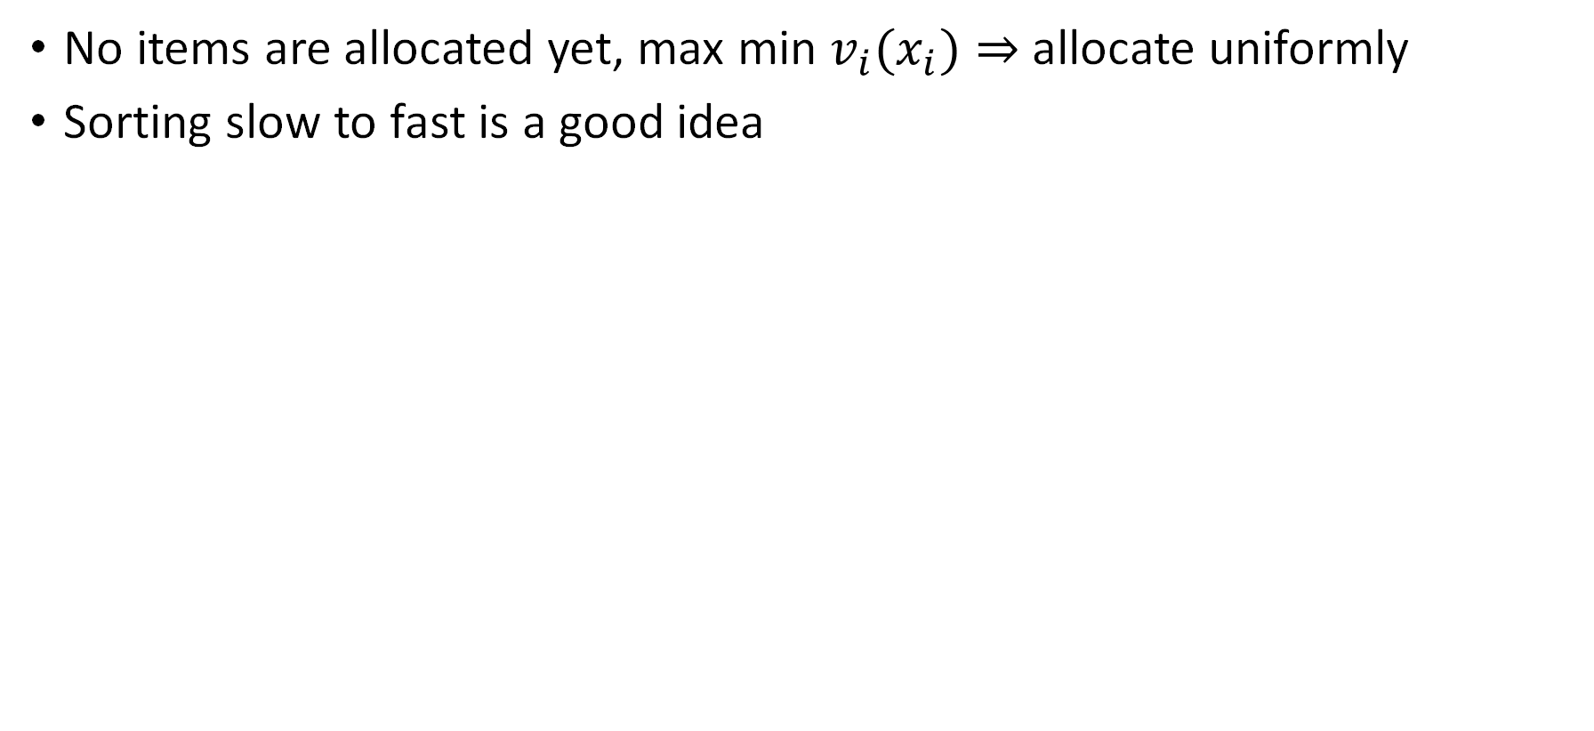
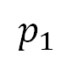

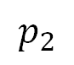
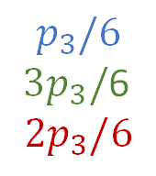
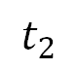
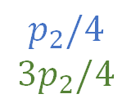
Allocating the first item
No items are allocated yet, max min ${v_{i}(x}_{i})⇒$ allocate uniformly
Sorting slow to fast is a good idea
0
$$∞$$
$$t_{1}$$
$$t_{2}$$
$$p_{1}$$
$$p_{2}$$
$$p_{3}$$
$$t_{1}$$
$$t_{2}$$
1
3
2
$$p_{1}$$
$$p_{2}/4$$
$$3p_{2}/4$$
$$p_{3}/6$$
$3p_{3}/$6
$$2p_{3}/6$$
doesn’t need a head-start over
3
2

Slide 26
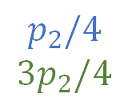
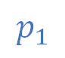
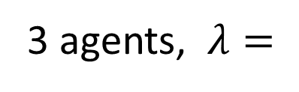
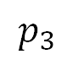
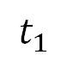
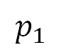
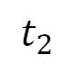
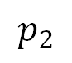
Allocating the first item
No items are allocated yet, max min ${v_{i}(x}_{i})⇒$ allocate uniformly
Sorting slow to fast is a good idea
3 agents, $λ=$
1
2
3
$$p_{1}$$
$$p_{2}$$
$$p_{3}$$
0
$$t_{1}$$
$$t_{2}$$
$$p_{1}$$
$$p_{2}/4$$
$$3p_{2}/4$$
$$p_{3}/6$$
$3p_{3}/$6
$$2p_{3}/6$$
doesn’t need a head-start over
3
2
Notes:
Suppose we don’t sort slow to fast

Slide 27
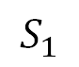
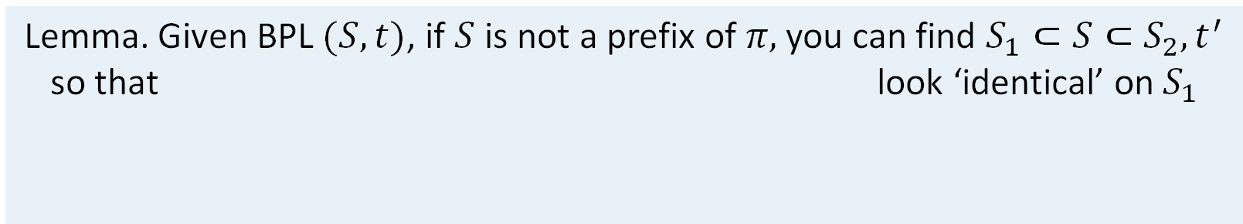
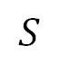
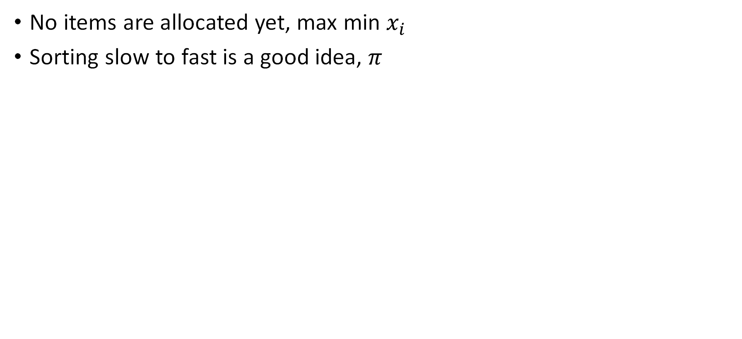
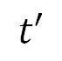




Allocating the first item
1
2
3
No items are allocated yet, max min $x_{i}$
Sorting slow to fast is a good idea, $π$
Lemma. Given BPL $(S, t)$, if $S$ is not a prefix of $π,$ you can find $S_{1}⊂S⊂S_{2}, t^{′}$ so that look ‘identical’ on $S_{1}$
$$S$$
$$t$$
$$S_{1}$$
$$t′$$
$$S_{2}$$
$$t$$
Thm. The optimal priority set in a binary priority list is some prefix of $π.$
Given the set you can find the optimal priority time with a linear program.

Slide 28












Binary priority lists: Allocating the first item
No items are allocated yet, max min $x_{i}$
Sorting slow to fast is a good idea, $π$ sorts this way
Lemma. Given BPL $(S, t)$, if $S$ is not a prefix of $π,$ you can find $S_{1}⊂S⊂S_{2}, t^{′}$:
Feasible: Equal P(alloc by $t)$
$x_{i}^{′}≥x_{i}∀$ $i∈S_{1}$
$$S$$
$$t$$
$$S_{1}$$
$$t′$$
$$S_{2}$$
$$t$$
$$S$$
1
2
4
$$t$$
1
2
3
4
1
2
$$t′$$
1
2
3
4
$$t$$
1
2
3
4
$$S_{1}$$
$$S_{2}$$
Notes:
If original satisfies allocation constraint, we still do
Objective weakly increases

Slide 29







Binary priority lists: Allocating the first item
No items are allocated yet, max min $x_{i}$
Sorting slow to fast is a good idea, $π$ sorts this way
Lemma. Given BPL $(S, t)$, if $S$ is not a prefix of $π,$ you can find $S_{1}⊂S⊂S_{2}, t^{′}$ so that look ‘identical’ on $S_{1}$
$$S$$
$$t$$
$$S_{1}$$
- Equal P(alloc by $t)$
- $S_{1}≥$ exp. by $t$
$$t′$$
$$S_{2}$$
$$t$$
$$S$$
1
2
4
$$t$$
1
2
3
4
1
2
$$t′$$
1
2
3
4
$$t$$
1
2
3
4
$$S_{1}$$
$$S_{2}$$

Slide 30

Binary priority lists
Sorting slow to fast is a good idea, $π$ sorts this way
For later items, do binary search on the objective function
For any target obj. ${z, x}_{i}^{z}$ is the amount $i$ needs to reach objective value $z$
Sort by decreasing $x_{i}^{z}/λ_{i}$, check all prefixes
Works for valuation functions strictly monotone in $x_{i}$
Thm. The optimal priority set in a binary priority list is some prefix of $π.$
Given the set you can find the optimal priority time with a linear program.

Slide 31










$n$-stage priority lists
Binary search over $z^{∗}$
$π$prioritizes by $x_{i}^{z}/λ_{i}$
Lemma 1. Given BPL $(S, t)$, if $S$ is not a prefix of $π,$ you can find $S_{1}⊂S⊂S_{2}, t^{′}$:
Feasible: Equal P(alloc by $t)$
$x_{i}^{′}≥x_{i}∀$ $i∈S_{1}$
$$S$$
$$t$$
$$S_{1}$$
$$t′$$
$$S_{2}$$
$$t$$
Lemma 2. Consider consecutive periods $\left(H, t_{H}\right), \left(L, t_{L}\right).$If $λ\left(H\right)>λ\left(L\right),$then there exists $t_{H}^{′}, t_{L}^{′}$ so that $t_{H}^{′}+t_{L}^{′}≤t_{H}+t_{L}$ and all allocation probabilities remain the same in the schedule$\left(L, t_{L}^{′}\right),\left(H, t_{H}^{′}\right)$

Slide 32




$n$-stage priority lists
Given order, you can find optimal announcement times
Binary search over $z$
Thm. For any objective value $z,$ if $z$ is achievable then prioritizing by $x_{i}^{z}/λ_{i}$ works
Initial PL
3
13
134
1234
Repeated
decomp.
$$∅$$
13
1
123
1
1234
1234
Lemma 1 +
memoryless
$$∅$$
1
123
1
123
1
1234
1234
$$D_{t}$$
Final PL
$$∅$$
1
1
1
123
123
1234
1234
Sorting lemma

Slide 33



Allocating the first item
No items are allocated yet, max min $x_{i}$
Sorting slow to fast is a good idea, $π$
This idea + binary search on $z^{∗}$ extends to
$x_{i}^{z}$ is the amount $i$ needs to reach objective value $z$
future items, $π$ orders by $x_{i}^{z}/λ_{i}$
monotone objective functions
any number of stages (needs a sorting lemma)
Thm. The optimal priority set in a binary priority list is some prefix of $π.$
Given the set you can find the optimal priority time with a linear program.

Slide 34

Binary PL Add image illustrating

Slide 35
Binary PL
Done – (at least for max number of items received, first item)
order slowest to fastest
No gaps, if gaps, apply lemma

Slide 36
Binary PL
This generalizes x^z, etc

Slide 37
Simulations
Allocation data 2017-2023
Estimate response rates
Draw donors, donation sizes, deadlines from historical distributions
Two valuation functions: Number of items, total pounds
Compare current system, binary PL, n-stage PL
Notes:
65% claimed by 1 hour; 60% items available for 1 day

Slide 38

Notes:
No increase in waste

Slide 39


Notes:
No increase in waste

Slide 40
Notes:
Exciting area
Compared to previous online fairness models ive worked on some challenges: limited value information, limited control over the allocation

Slide 41


Extensions
Offering transportation services
Breaking bulk
Other allocation policies: Best-of-2, etc.

Slide 42

Discussion
Related exciting work
Vaccine allocation, food truck (by Sid Banerjee, Sean Sinclair et al.)
Gap between theory and practice
Very few organizations elicit agent values (Feeding America)
The algorithm doesn’t usually get to decide the allocation
Logistical constraints: box trucks, storage space, current demand, etc.
Notes:
Deciding the allocation: with agents arriving model request as stochastic, items arriving

